Slide 1
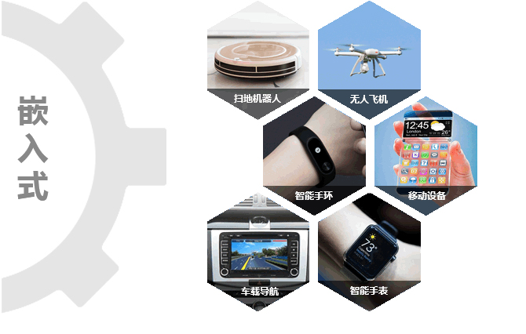
Software Engineering
1809 Yang Mengheng
Liao Yanhao

Slide 2

What is Embedded System?

Slide 3
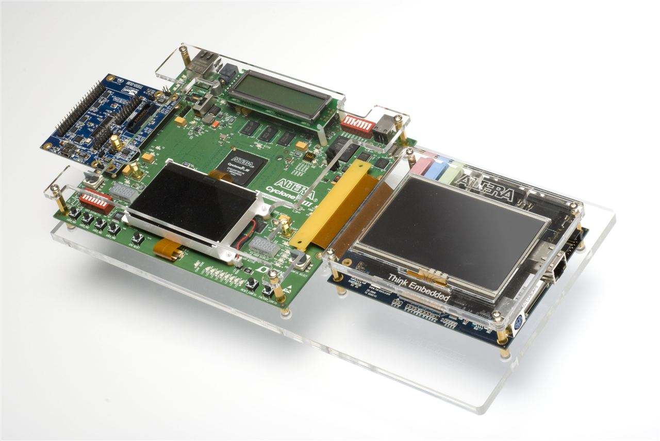
Is it a Embedded System?

Slide 4
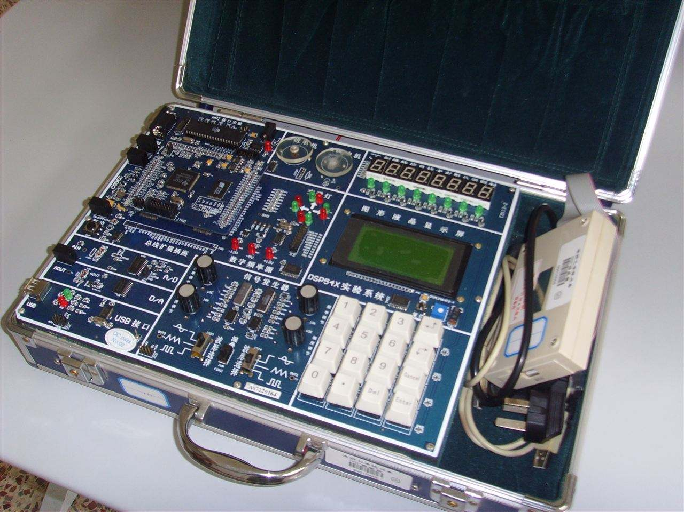
Is this one?

Slide 5
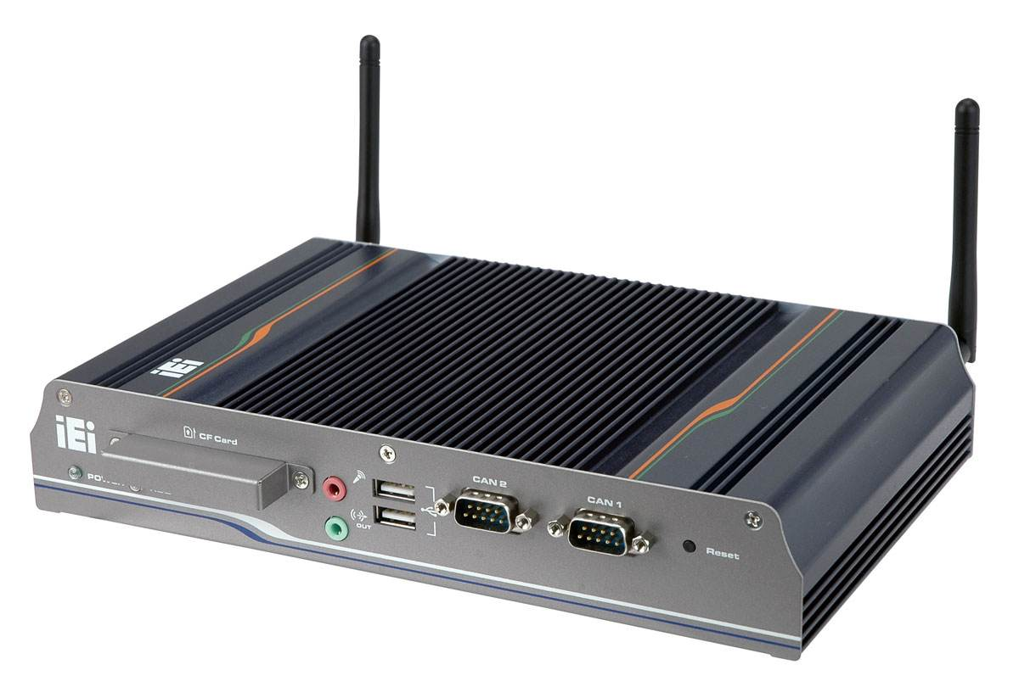
Or this one?

Slide 6
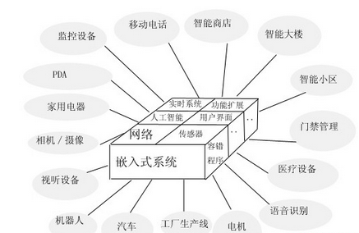
In fact, they are all embedded system designs. Embedded is everywhere in our society, and it involves a lot of unexpected aspects.

Slide 7
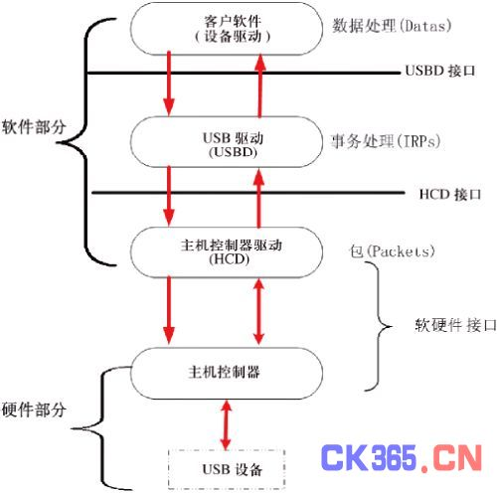
Embedded mainly includes two parts, one is the software part, directly facing the customer, is the external manifestation of embedded system. The second is the hardware part, which is the carrier of embedded system, and also the performance carrier of embedded system software.

Slide 8
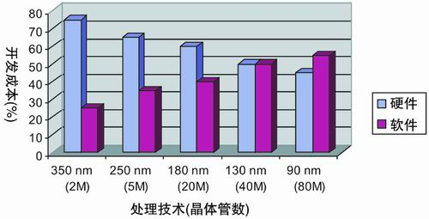
The Cost of Embedded System

Slide 9

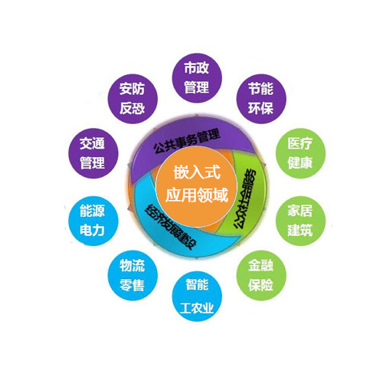
Without embedded, our lives could be radically different.
In life, embedded application involves all aspects, embedded everywhere.

Slide 10
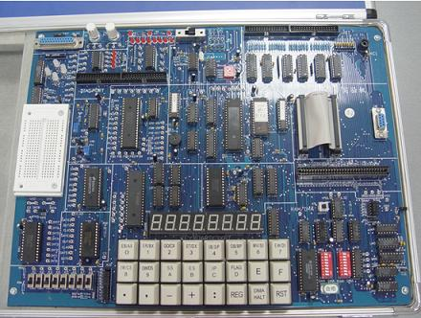
Now let's take ARM embedded system as an example to introduce embedded system.

Slide 11
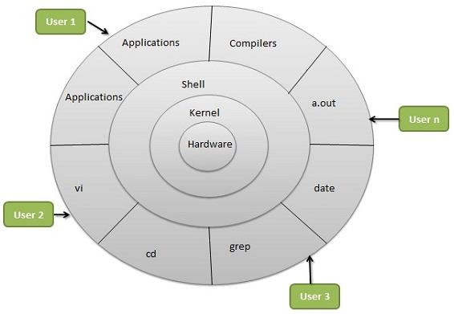
This is a basic embedded system architecture, and our ARM embedded system is designed on this basis.

Slide 12
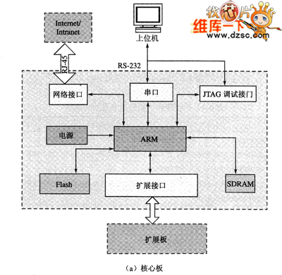
rchitecture of ARM embedded system

Slide 13
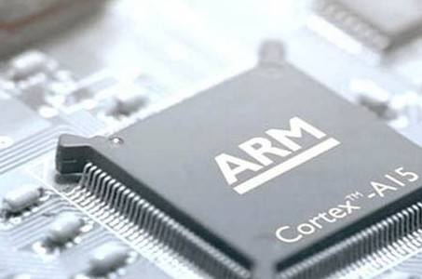
Cortex-A15
The cortex-a15 MPCore processor is A member of the cortex-a family of processors, ensuring full compatibility with all other highly acclaimed cortex-a processors in terms of application. In this way, you can immediately access has recognized development Platform and software system, including Android, Adobe ® Flash ® Player, Java Platform Standard Edition (Java SE) and deployment headaches, Linux and Microsoft Windows Embedded, Symbian and Ubuntu, and more than 700 ARM Connected Community members, These members provide application software, hardware and software development tools, middleware, and SoC design services.

Slide 14

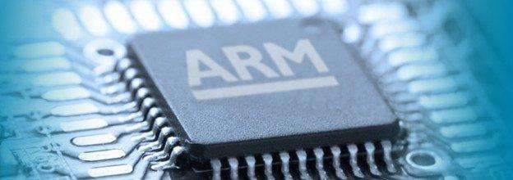
Cortex-a15 MPCore processor, compared to the current advanced smartphone processor, can bring the same level of power consumption on the performance improvement of five times. Architecture (A15 processor architecture based on ARMv7 - A micro architecture, 1-4 SMP cluster with A single processor core, connected each other by AMBA 4 technology, support A series of ISA to falling consumption, heat dissipation, and highly scalable solutions on the basis of cost budget, widely applies to the next generation of smartphones, tablet, big screen mobile computing devices, high-end digital home entertainment terminal, wireless base stations, enterprise infrastructure products and so on. The processor's main frequency is up to 2.5ghz and can be flexibly adjusted according to different application fields, such as 1-1.5ghz single/dual core of smart phone and mobile computing, 1-2ghz dual/four core of digital home entertainment, 1.5-2.5ghz quad-eight core of home and Web 2.0 server and even larger scale interconnection.

Slide 15
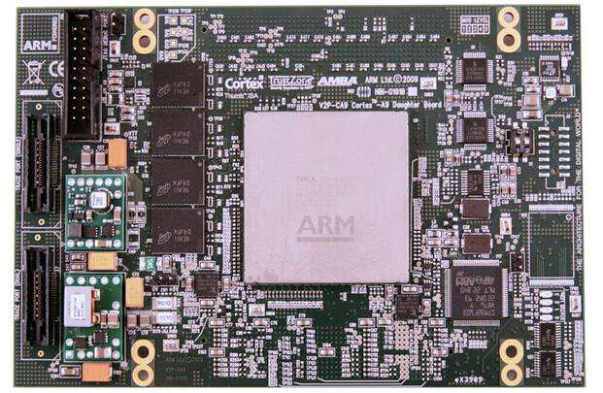
Sample of ARM Embedded System

Slide 16
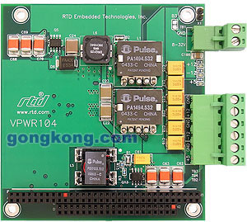

Slide 17
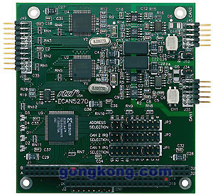

Slide 18

Then there is the RTOS embedded real-time multitasking operating system, which is often used in daily life.

Slide 19

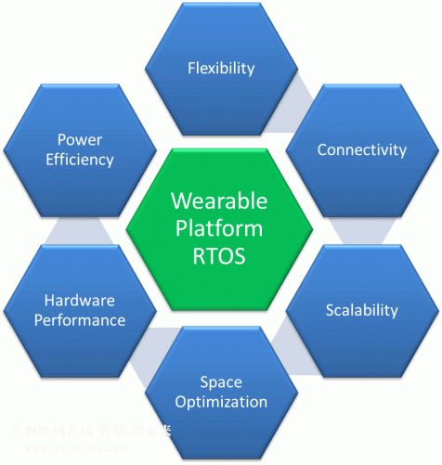
Basic architecture of RTOS

Slide 20
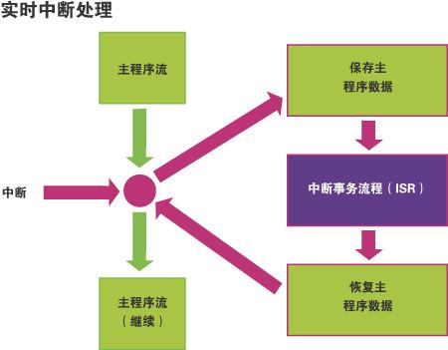
Real-time interrupt processing is a typical RTOS, through which we can easily control the process of things.

Slide 21

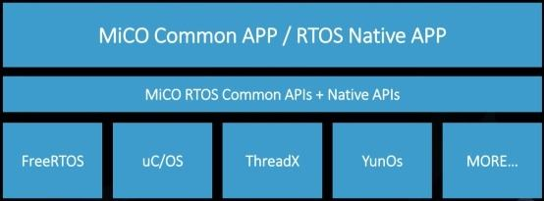
Real time is the actual time of a physical process, according to the operating system's operating characteristics. Real-time operating system refers to the operating system with real-time, can support the work of real-time control system. Its primary task is to dispatch all available resources to complete real-time control tasks, and then focus on improving the use efficiency of computer system, an important feature is to meet the time constraints and requirements. Generally speaking, for time-sharing operating systems, the execution of software is not strictly required in terms of time, and errors in time generally do not cause disastrous consequences. But for real-time operating systems, the main task is to require real-time processing of events, although events may arrive at unpredictable times. However, the software must be able to respond to events within a strict time limit (system response time), even if it can, but if the time limit is exceeded, the timeout of the system time response means a fatal failure. The important characteristic of real-time operating system is the certainty of the system, that is, the system can make accurate estimation of the best and worst operating conditions.

Slide 22
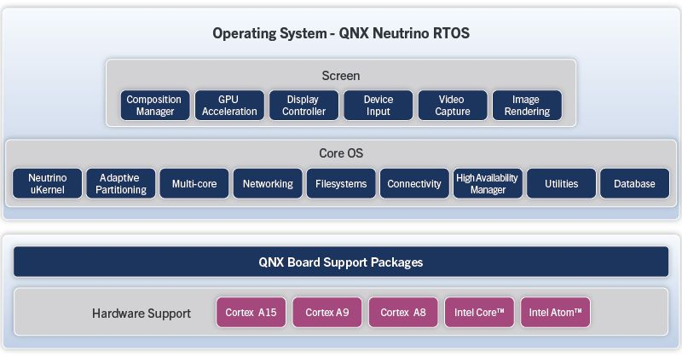

Slide 23
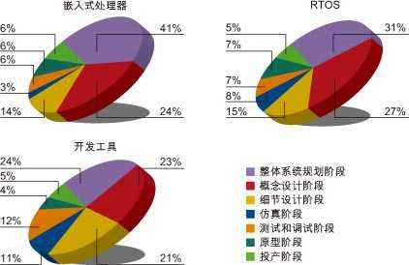
RTOS and ARM

Slide 24

What can RTOS do for us

Slide 25
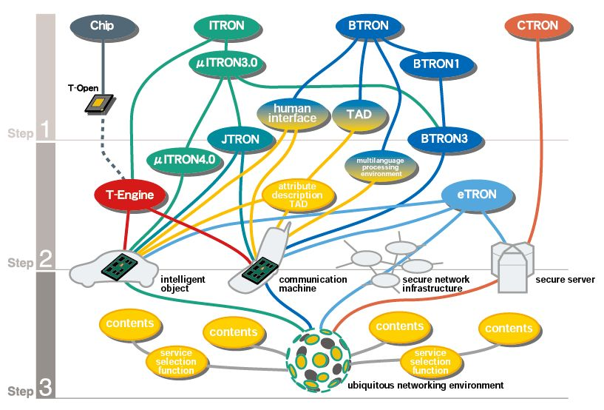

Slide 26
In addition to RTOS, embedded systems can also provide great assistance for one of the most important projects in our society. Network engineering.

Slide 27

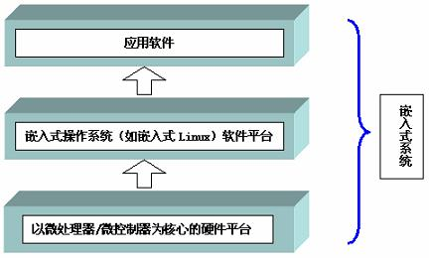
Through the embedded system, we can easily communicate with the network terminals between various regions and control the network more quickly. For a region, the connection between the region and each small terminal in the region is closer to achieve a terminal control. Both control efficiency and production revenue can be greatly improved. At the same time, these regions and regions, regions and subregions form different networks with each other to achieve the purpose of integration.

Slide 28
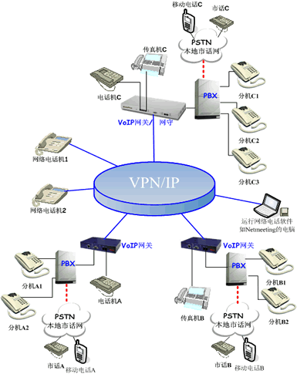
Network and embedded systems

Slide 29

The embedded world is more wonderful than we think, and there are many embedded things that we have not yet known. I am very happy that I can learn embedded development technology.

Slide 30

Thank you

